Slide 1
Ontologies and The Semantic Web
Course Project
Aliaa Abd El Karim | 18P1241
Farah Loay | 18P7388
Malak Mohamed | 18P9114
Nouran Ahmed | 18P4496
Nourhan Ayman | 18P5425

Slide 2

Introduction
Our project is based on a Music Ontology
We used the Protégé ontology editor to build our Music Ontology.
Then we created a java application where we will write a SPARQL query, press execute and see the results of the query displayed in the form of a table.
We also created a web application that contains a text field for the queries, a button to run the query and a table to display the results.

Slide 3
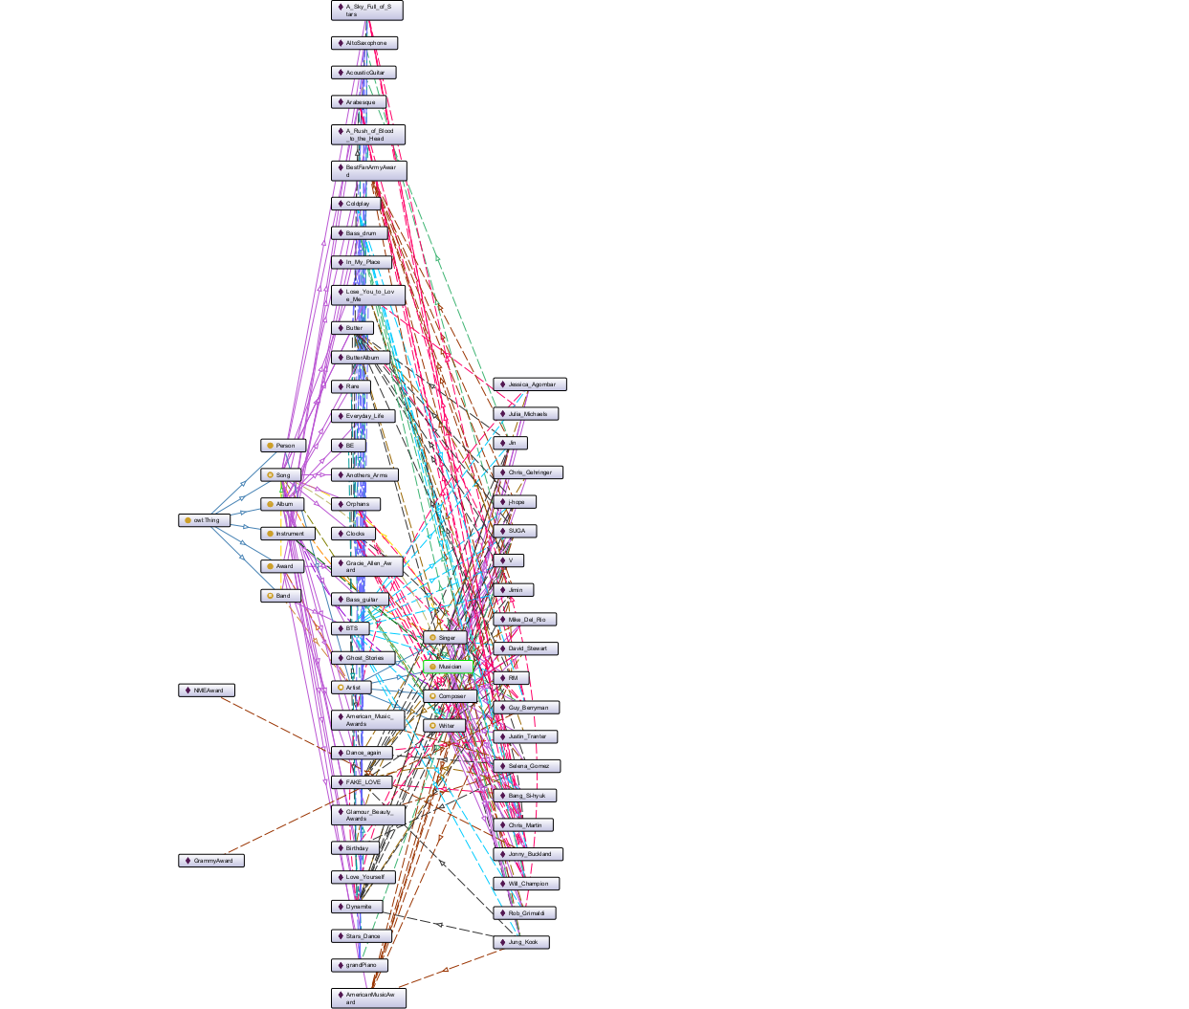
Ontology
Classes
Object properties
Restrictions
Data properties
Instances

Slide 4
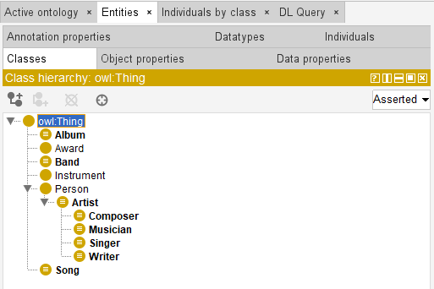
Classes
Album
Award
Band
Instrument
Person
Artist
Composer
Musician
Singer
Writer
Song

Slide 5
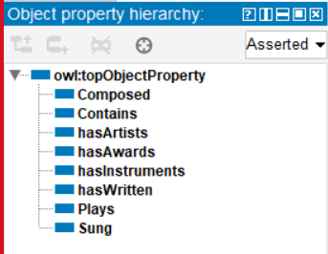
Object Properties
Composed: Composer , Song.
Contains: Album , Song.
hasArtists: Band , Artist.
hasAwards: Artist , Award.
hasInstruments: Song , Instrument.
hasWritten: Writer , Song.
Plays: Musician , Instrument.
Sung: Band/Singer , Song.

Slide 6
Restrictions
Each Album contains at least 1 and at most 15 songs
Each Band has at least 2 Artists
Each Band sung at least 1 song
Each Song has at least 1 instrument
Each Composer composed at least 1 Song
Each Musician Plays at least 1 Instrument
Each Singer sung at least 1 Song
Each Writer has Witten at least 1 Song

Slide 7
Data Properties
Data Property | Domain | Range
Name | Song Album Band Award Instrument Person | String
Nationality | Person | String
Release Date | Album Song | Date Time
Time Duration | Song | Decimal
Top Hits | Artist | String
Type | Award Instrument | String
Views | Song | Decimal
Genre | Song | String
Data Property | Domain | Range
Age | Person | Integer
Agent | Singer | String
Country | Band | String
Date | Band Award | Data Time
Description | Song | String
Emotions | Song | String
Gender | Person | String
ID | Song | long
Language | Song | String

Slide 8
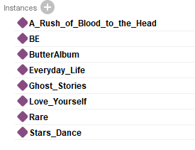
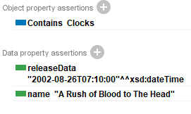
Instances of Album

Slide 9
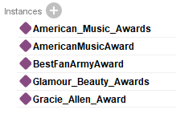
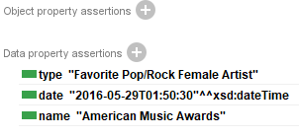
Instances of Award

Slide 10
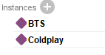
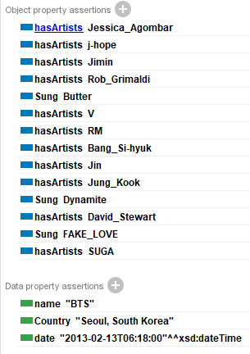
Instances of Band

Slide 11
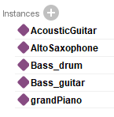
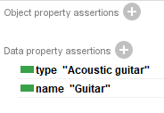
Instances of Instrument

Slide 12
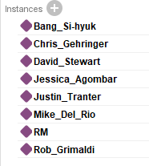
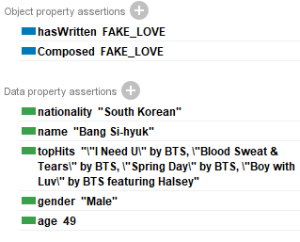
Instances of Composer

Slide 13
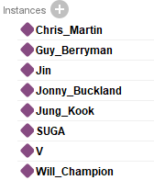
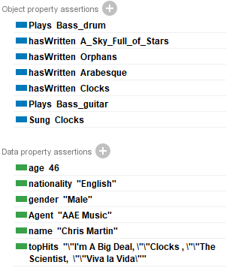
Instances of Musician

Slide 14
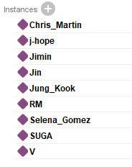
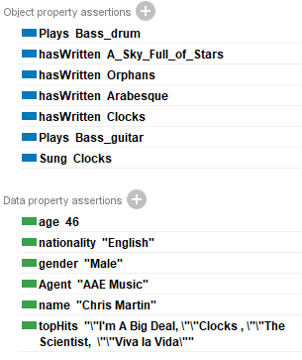
Instances of Singer

Slide 15
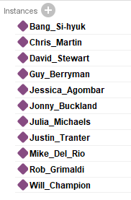
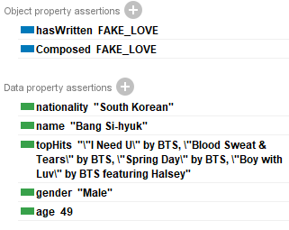
Instances of Writer

Slide 16
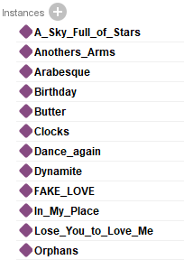
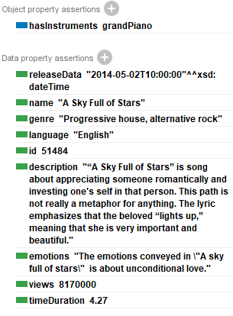
Instances of Song

Slide 17
Java Application
GUI
Code

Slide 18
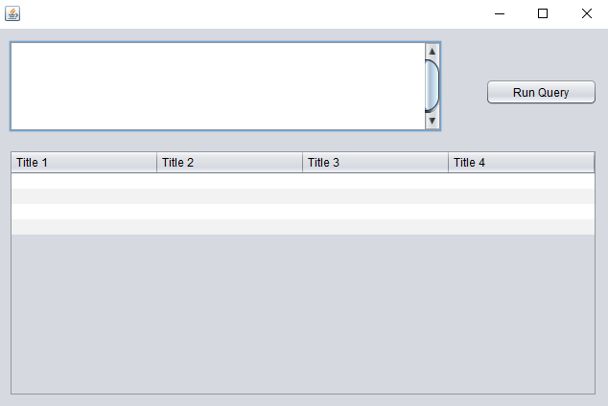
GUI
Text field to write the queries in.
Button to run the query.
Table to display the result of the query.

Slide 19
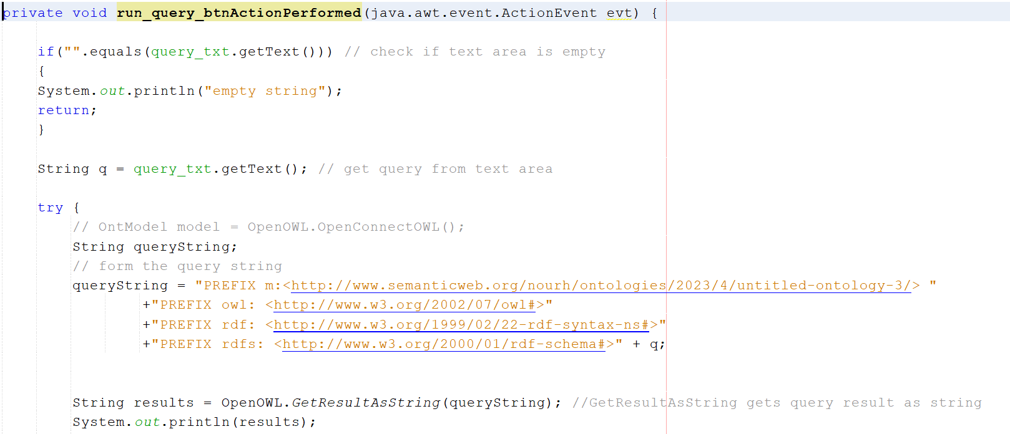
Code

Slide 20
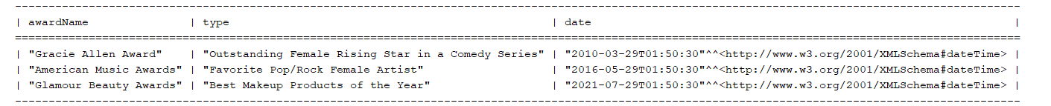
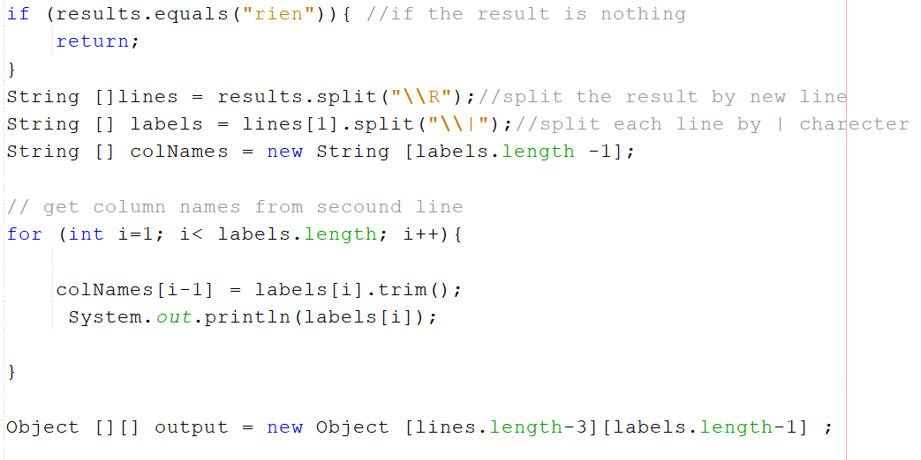
Code

Slide 21
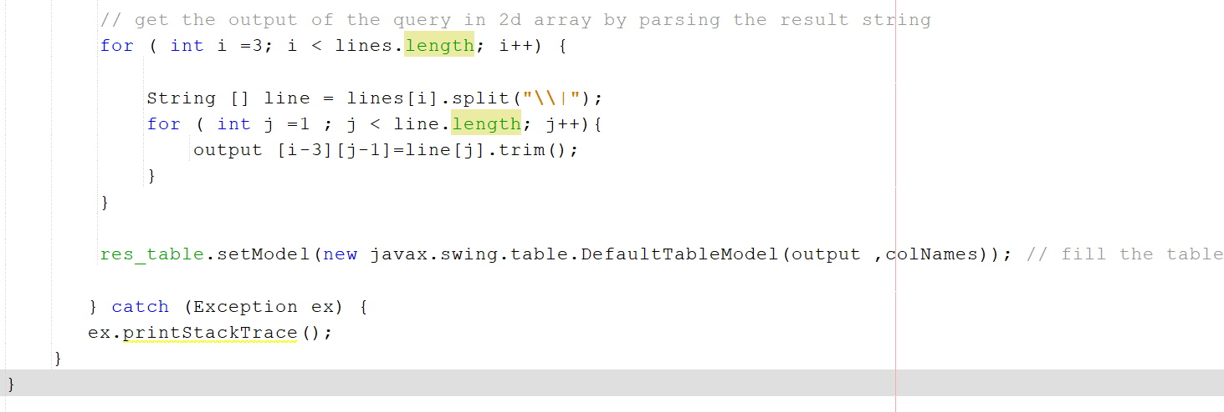
Code

Slide 22
Java Script Web App
GUI
Apache Jena Fuseki Server
Code

Slide 23
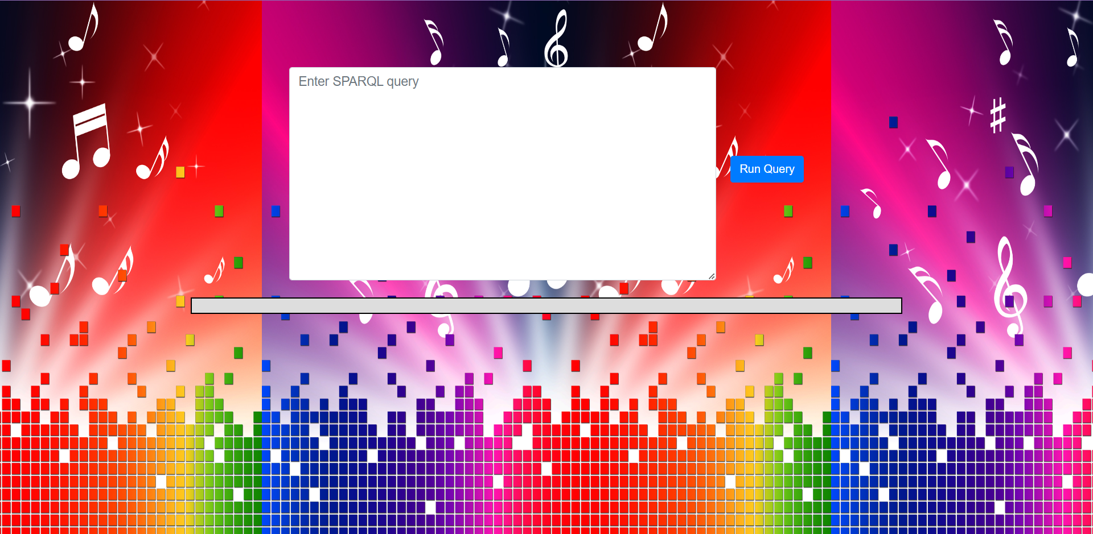
GUI
Text field to write the queries.
Button to run the query.
Table to display the result of the query.

Slide 24
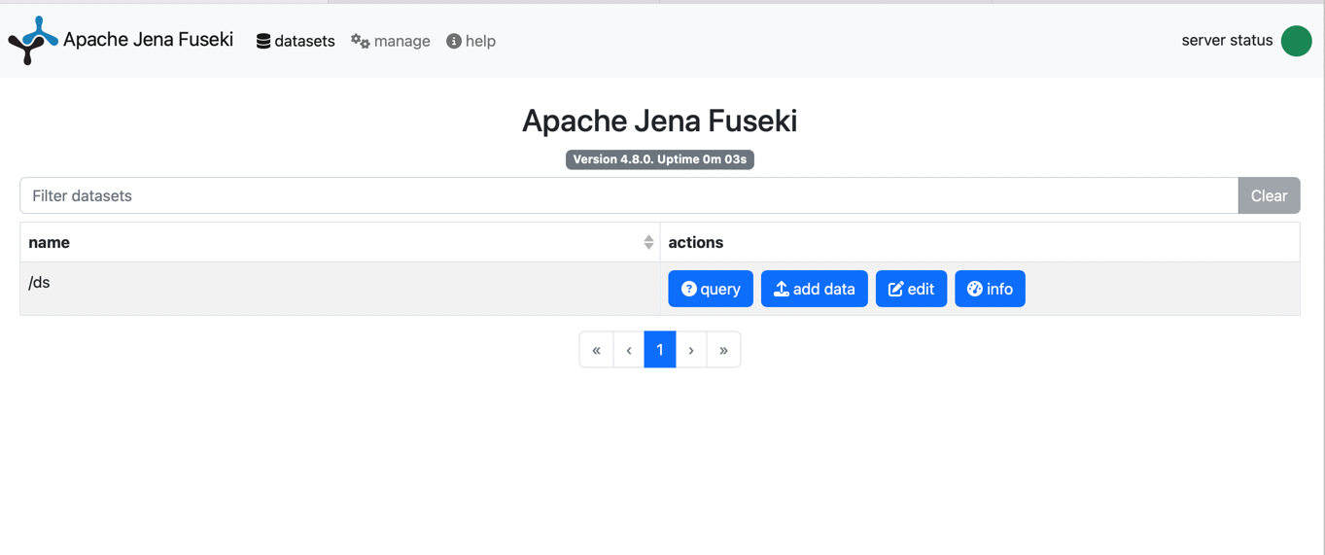
Apache Jena Fuseki Server

Slide 25
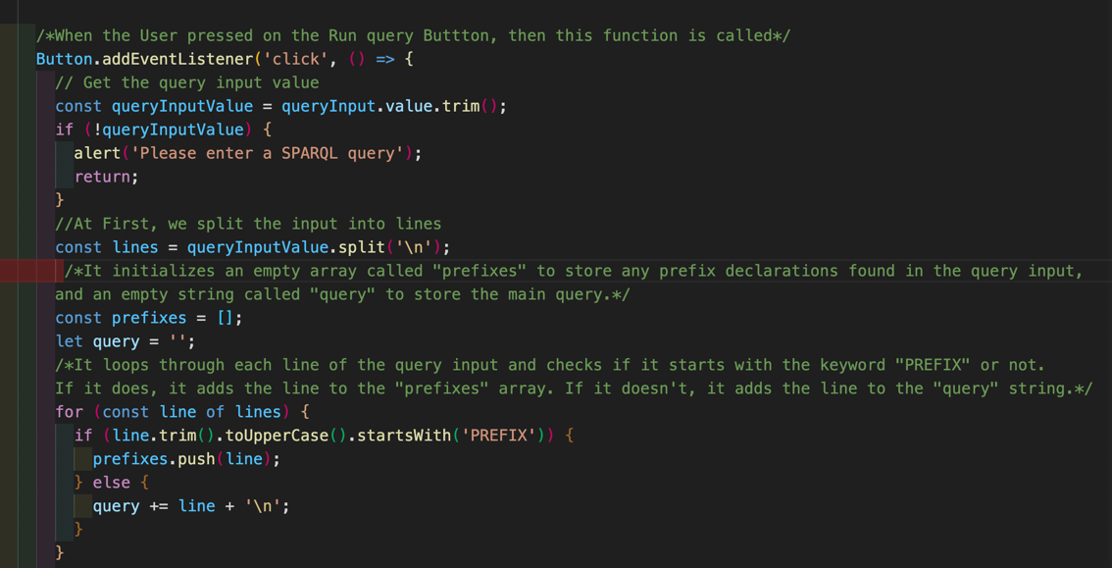
Code

Slide 26
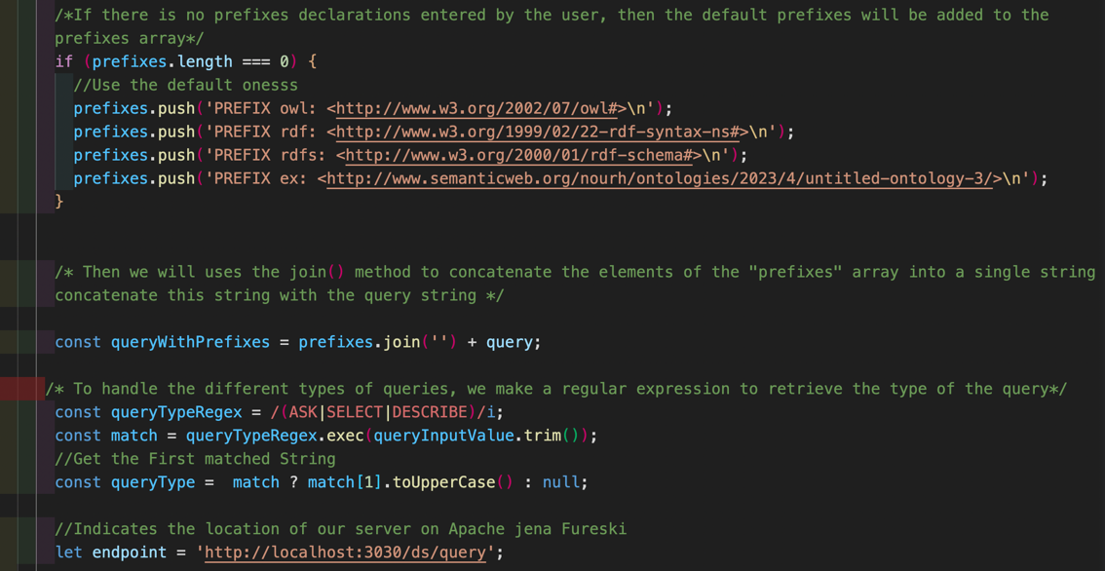
Code

Slide 27
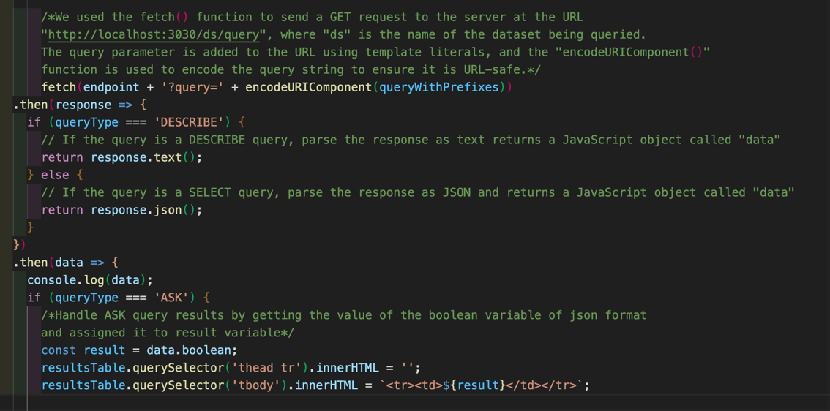
Code

Slide 28
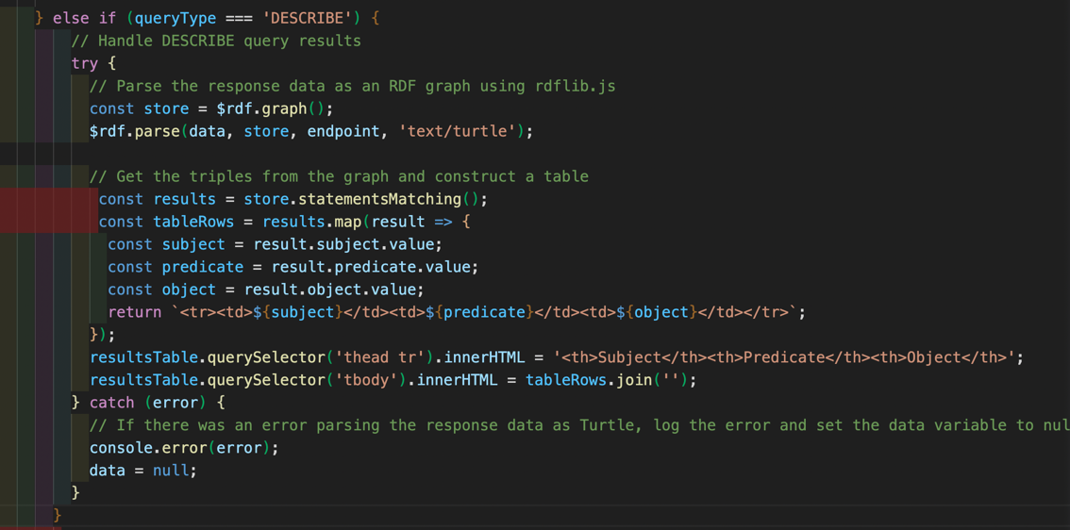
Code

Slide 29
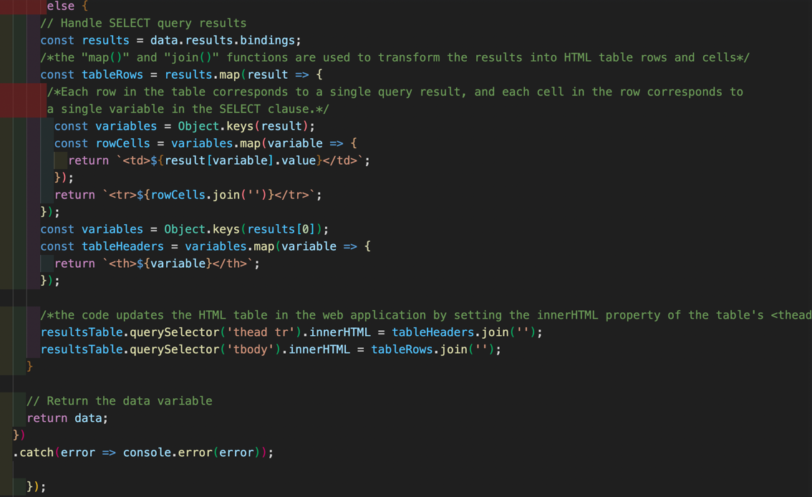
Code

Slide 30
SPARQL Queries and Results
Select Queries
Ask Queries
Describe Queries

Slide 31
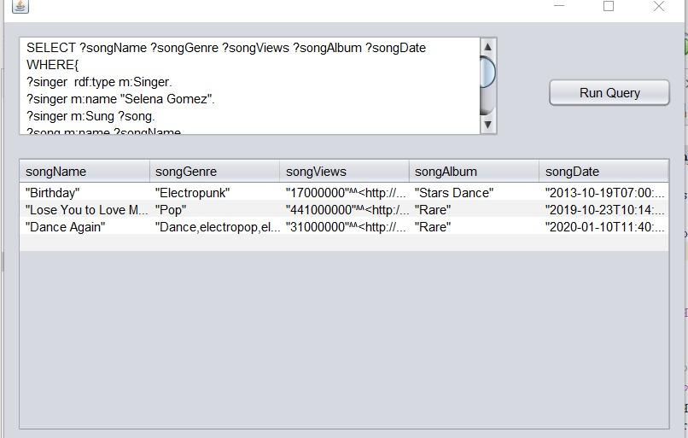
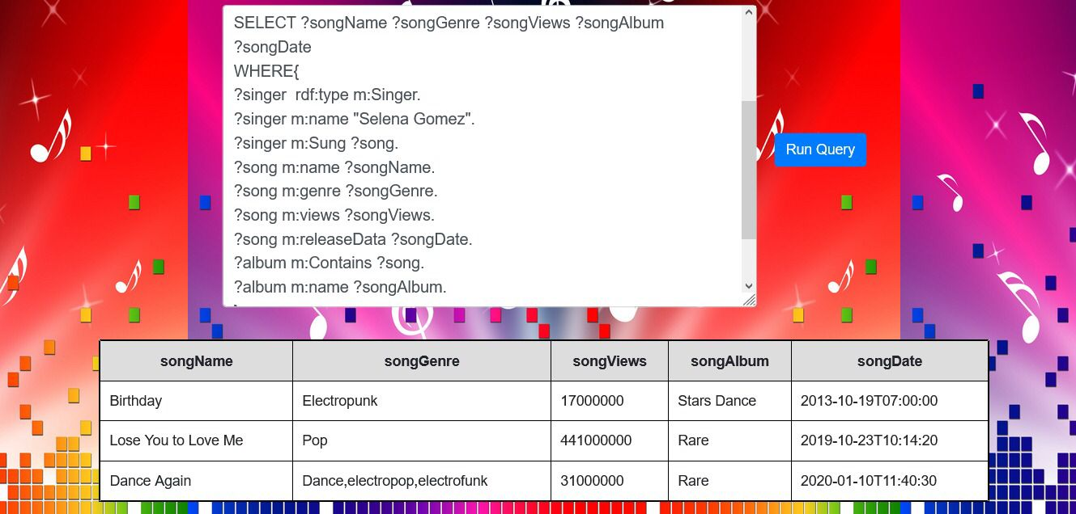
Select Query 1
List the songs(name, genre, views) sung by Selena Gomez ordered by release date and the album that each song belong to.
Java app result
Web app result

Slide 32
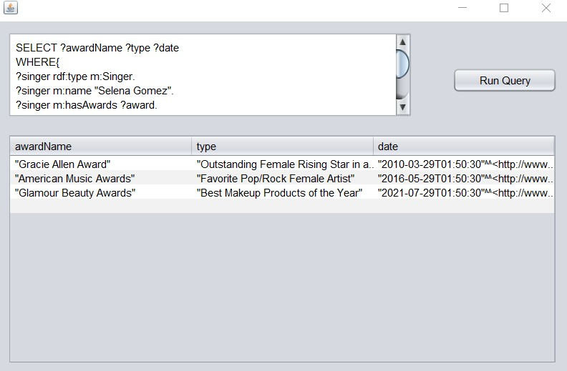
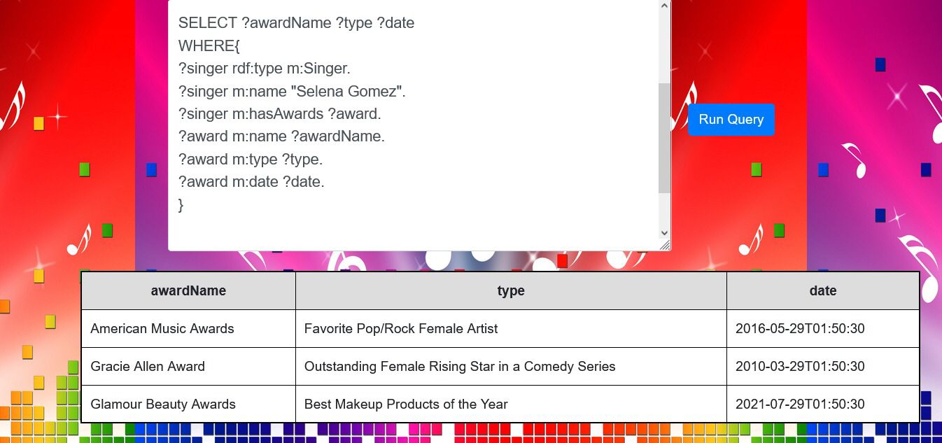
Select Query 2
List the awards taken by Selena Gomez with the date and type.
Java app result
Web app result

Slide 33
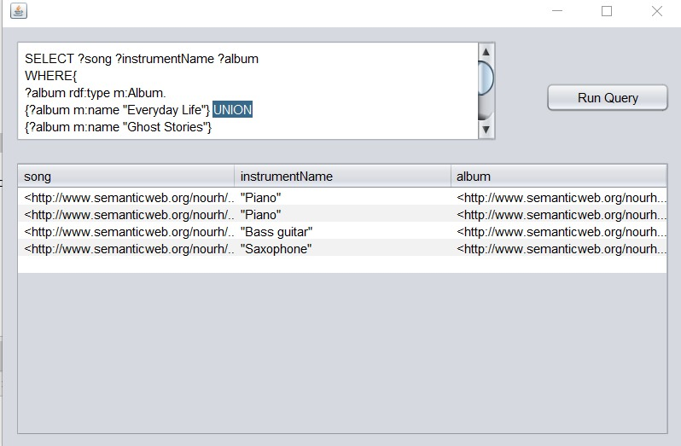
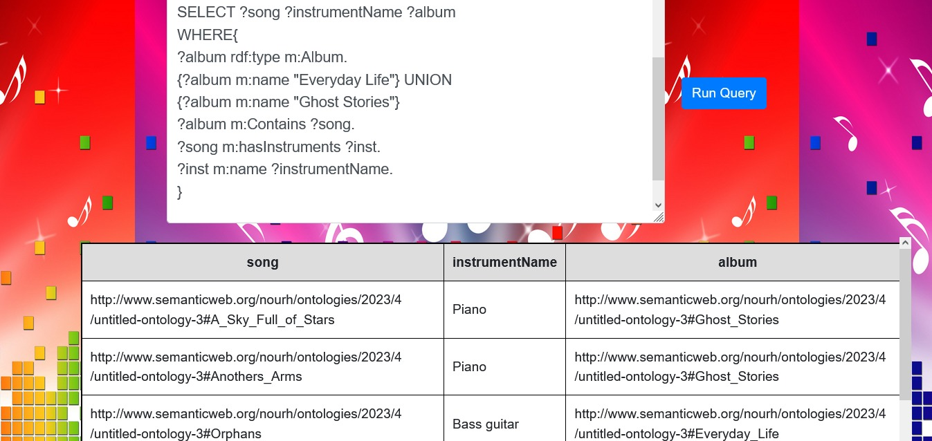
Select Query 3
List the songs of the album everyday life or ghost stories with the instrument used in every song.
Java app result
Web app result

Slide 34
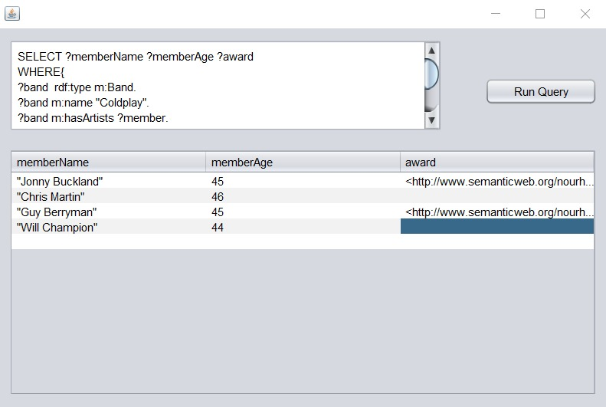
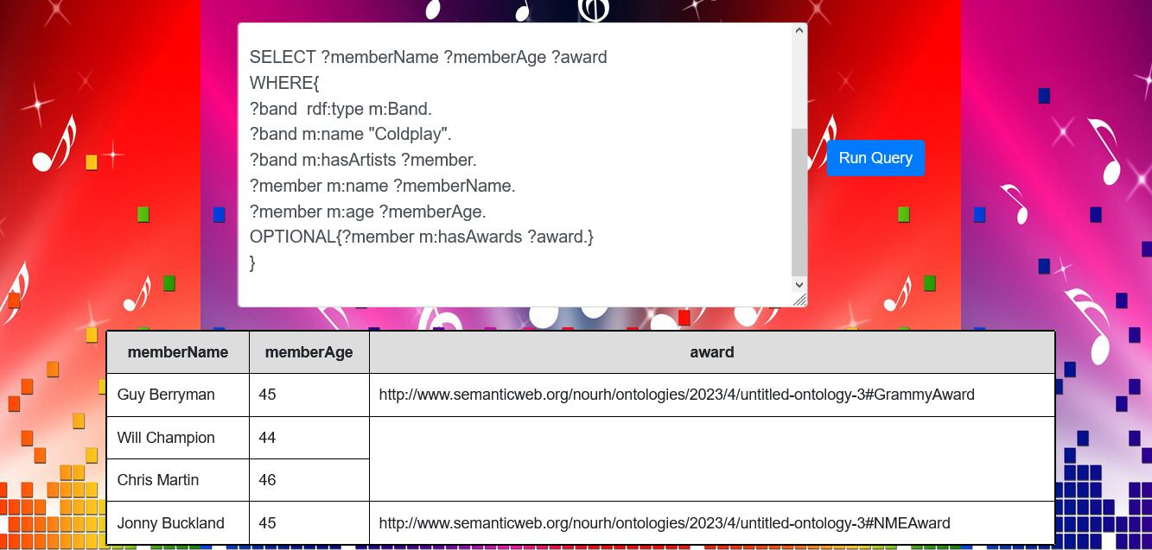
Select Query 4
List the names and the ages of the members of the band Coldplay and awards if they have.
Java app result
Web app result

Slide 35
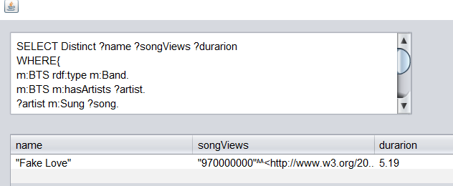
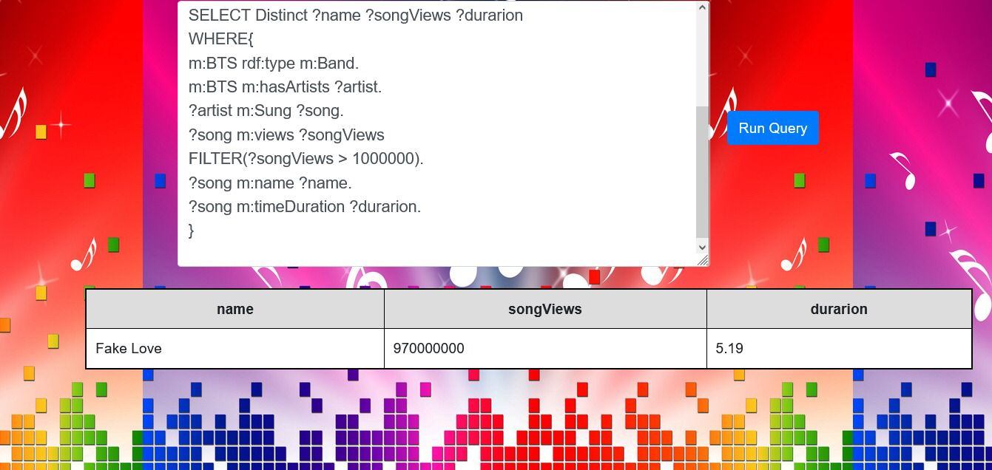
Select Query 5
List the songs of BTS band that exceed million views and their duration.
Java app result
Web app result

Slide 36
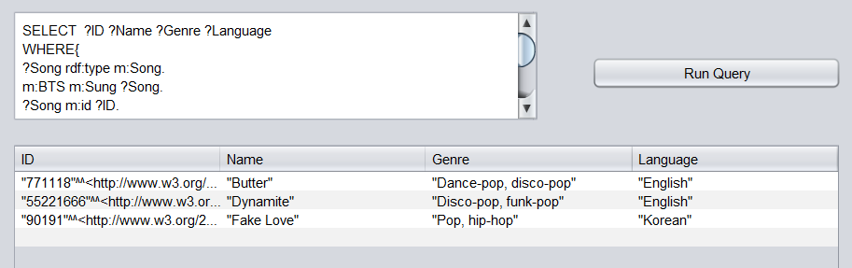
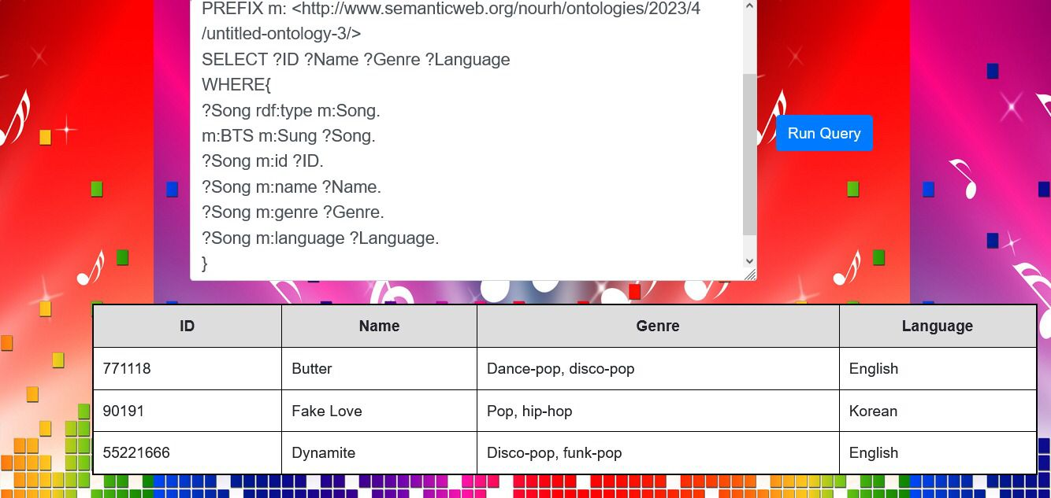
Select Query 6
List the Ids , names , genre and language of BTS songs.
Java app result
Web app result

Slide 37
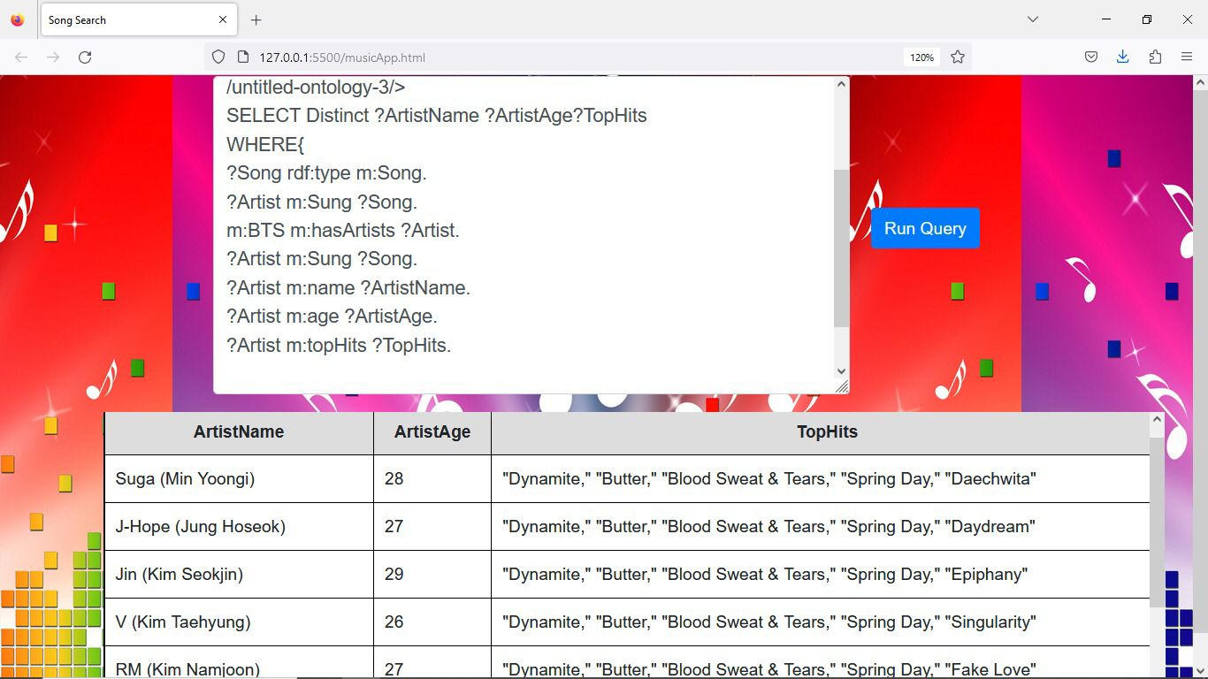
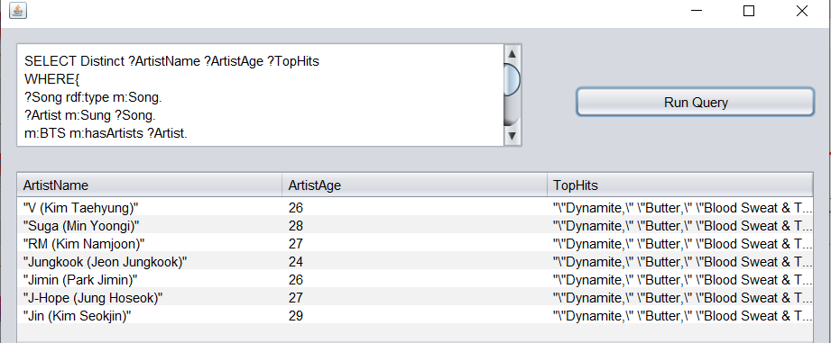
Select Query 7
List the artist names , ages and top hits of the BTS band that sung songs.
Java app result
Web app result

Slide 38
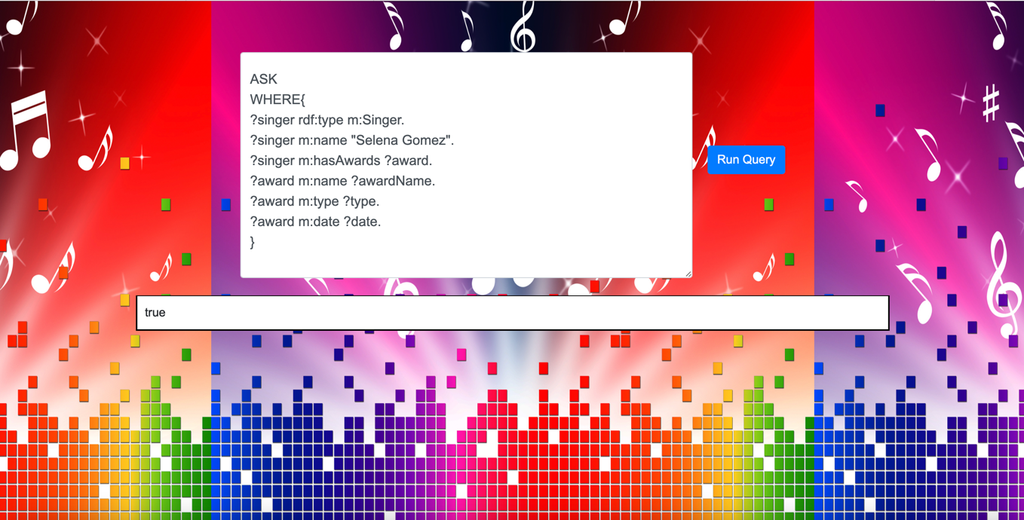
ASK QUERY 1
Ask if there exists a singer whose name is Selena Gomez , and has award. The award has a name, type and date.

Slide 39

ASK QUERY 2
Ask if there exists a singer whose name is Salma , and has award. The award has a name, type and date.

Slide 40
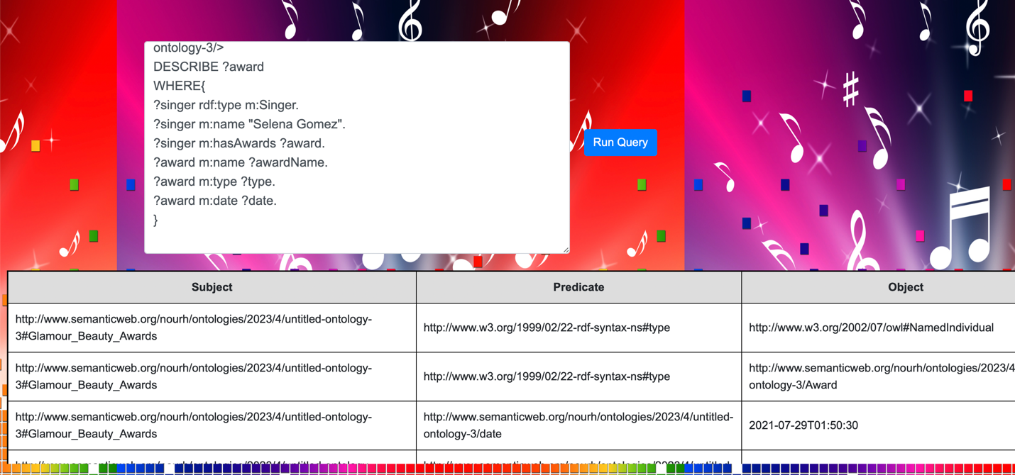
Describe QUERY 1
Describe the awards received by a singer whose name is Selena Gomez .The award has a name, type and date.

Slide 41
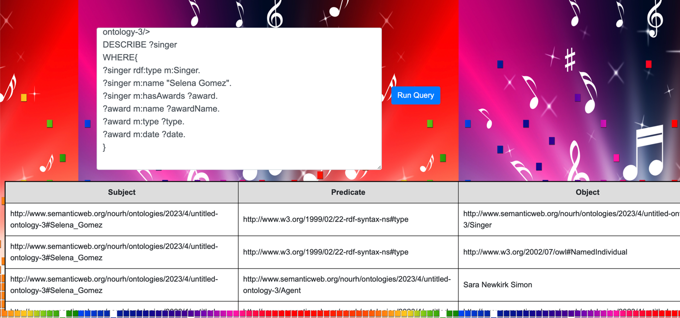
Describe QUERY 2
Describe the singer who received an award and whose name is Selena Gomez .The award has a name, type and date.

Slide 42
THANK YOU

